Slide 1

Cyber Security
Ransom
Presentation by:
Leong Hang Chang

Slide 2

What is Cyber Security
o1.
o2.
o3.
o4.
o5.

Slide 3
Why Is Cyber Security Important

Slide 4

Example Threat - Ransom
Ransom is a type of malware that locks or encrypts a victim's files
Demand a ransom payment (in crypto)
Ransom attacks can cost organizations millions of dollars through interruptions and recovery costs.

Slide 5

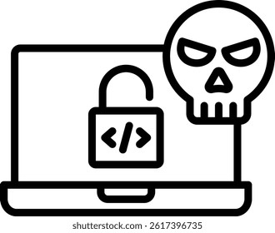




Ransom Attack Time Line
Initial Attack
Post-Exploitation
Understand & Expand
Attackers gets into system
Attacker installs tools to stay connected
Explores the network to gain more access
Data Collection
Ransomware Deployment
Extortion
Important files are stolen before encryption
Malware Encrypts files so victim cannot access
Attackers demand payment

Slide 6



Best Practice – Protection
Use Strong Passwords
Be Aware of Phising emails
Keep Software Updated
Create Unique Passwords
Do not click on suspicious links
Install security patches and update promptly

Slide 7

Thank you
Office hours:
M-Th 3:00pm-4:30pm room C402
Please send all questions to:
gehad@example.com

